Slide 1
CMPE 321 Computer Architecture
Registers and Instruction Set Examples

Slide 2
Registers
Registers with paralel load
Registers with serial load

Slide 3
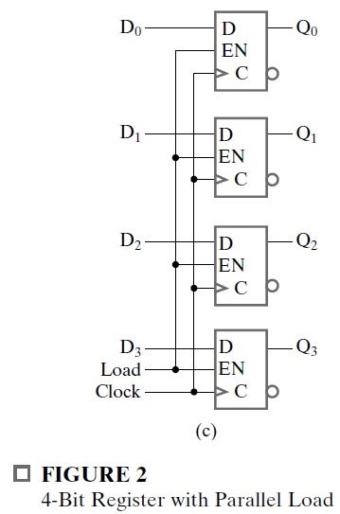
Registers with Paralel Load
Data will be loaded at the same clock

Slide 4
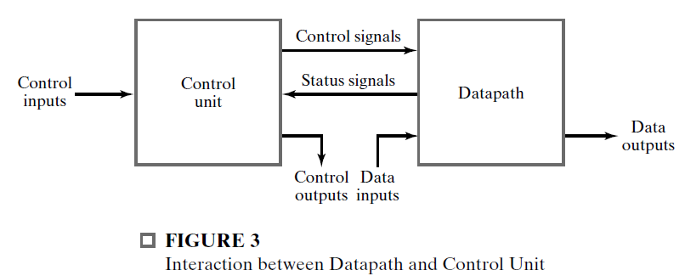
Register Transfer Operations
The register transfer operations of digital systems are specified by the following three basic components.
The set of registers in the system
The operations that are performed on the data stored in the registers
The control that supervises the sequence of operations in the system.

Slide 5
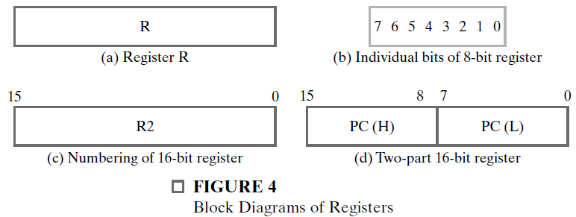
Block Diagrams

Slide 6
Type of Microoperations
Transfer Microoperations
Arithmetic Microoperations
Logical Microoperations
Shift Microoperations

Slide 7
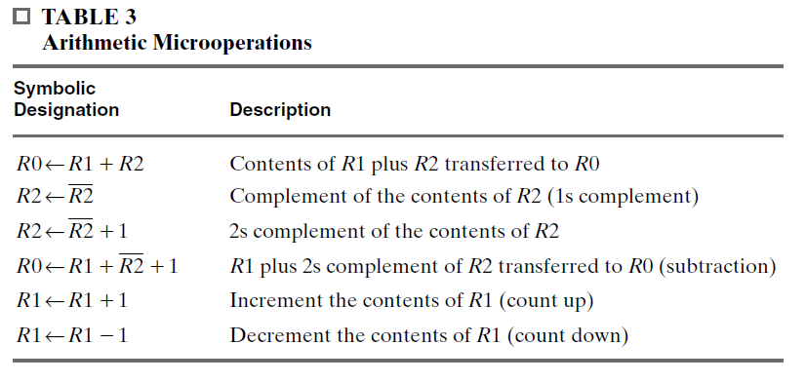
Arithmetic Microoperations

Slide 8


How?
Simplify the X:

Slide 9
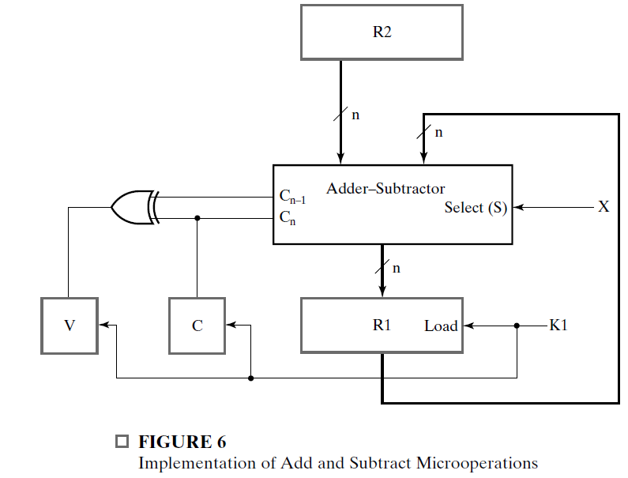

Slide 10
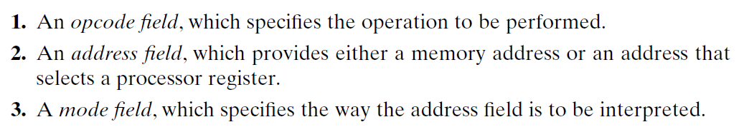
Instruction Set
The format of an instruction is depicted in a rectangular box symbolizing the bits of the binary instruction.
The bits are divided into groups called fields.
The typical fields in instruction format:

Slide 11
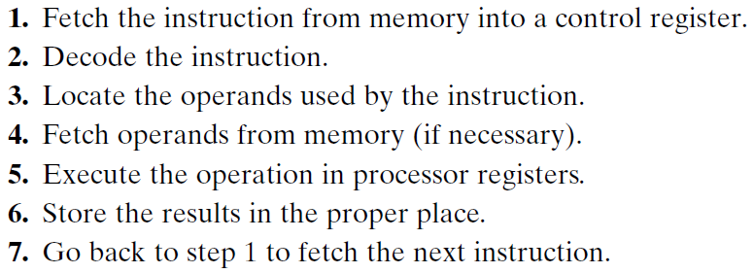
Steps...
The computer’s control unit is designed to execute each instruction of a program in the following sequence of steps:

Slide 12
Question 1

Slide 13
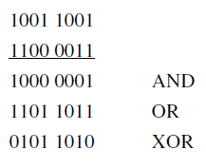
Answer 1

Slide 14
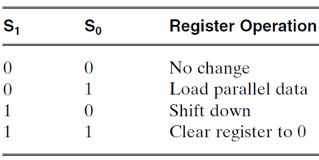
Question 2

Slide 15
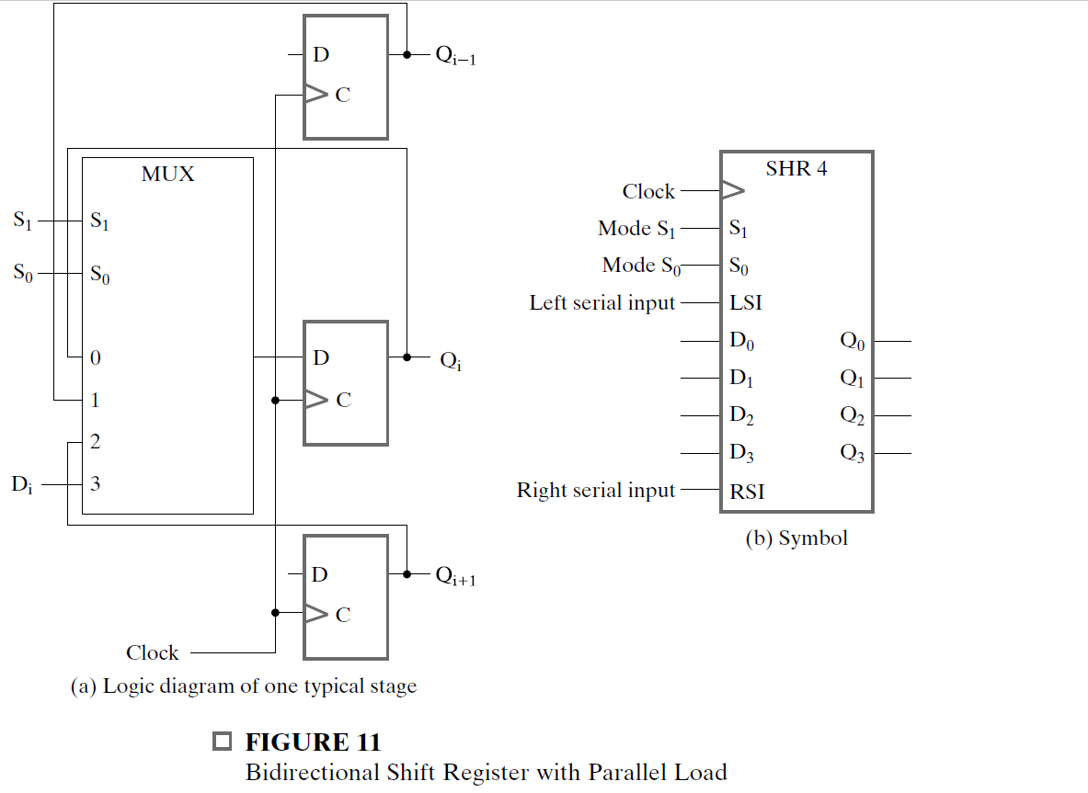
Question 2

Slide 16
Answer 2

Slide 17
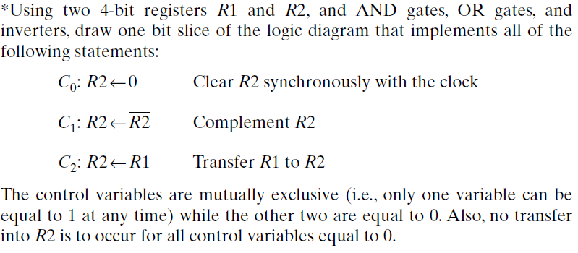
Question 3

Slide 18
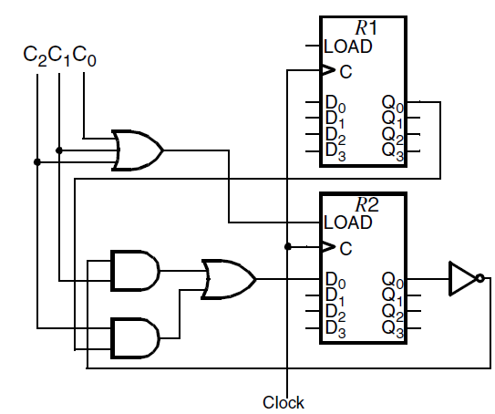
Answer 3

Slide 19
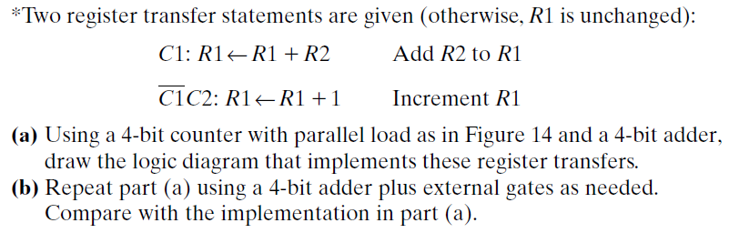
Question 4

Slide 20
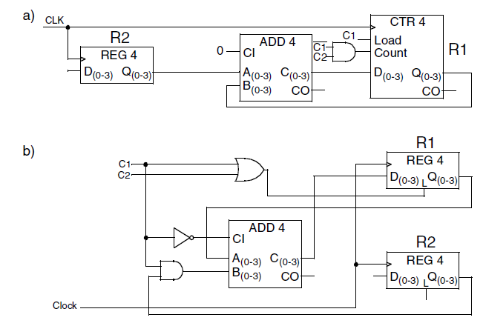
Answer 4

Slide 21
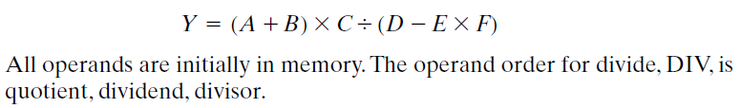
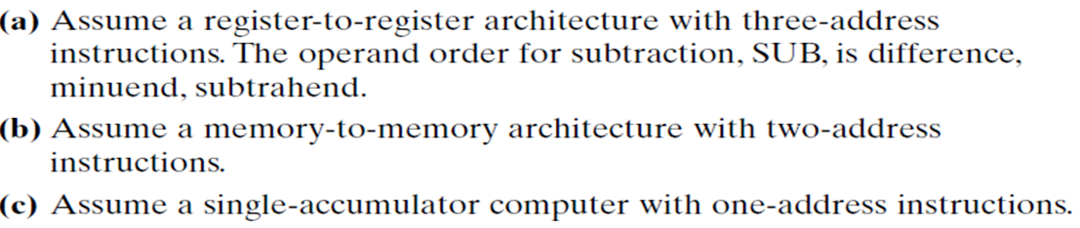
Question 5

Slide 22
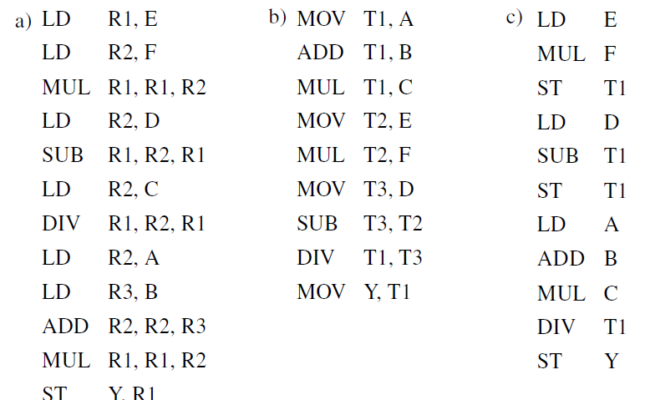
Answer 5

